Slide 1

Calculation of Line Tension using Phase Boundary Fluctuation Spectra in Kawasaki Ising Model
Chandan R T
4th Year UG Student at IISc
Project for PH322: Molecular Simulations course

Slide 2
Kawasaki Ising Model
In Ising Model under Kawasaki Dynamics, Monte Carlo moves involve exchange of spins. Owing to this constraint, net spin of the system remains constant. Hence, this framework can be used to study aspects of phase separation

Slide 3
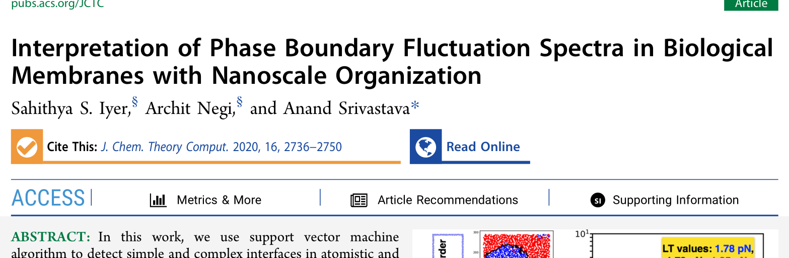
Reference for Math Methods

Slide 4
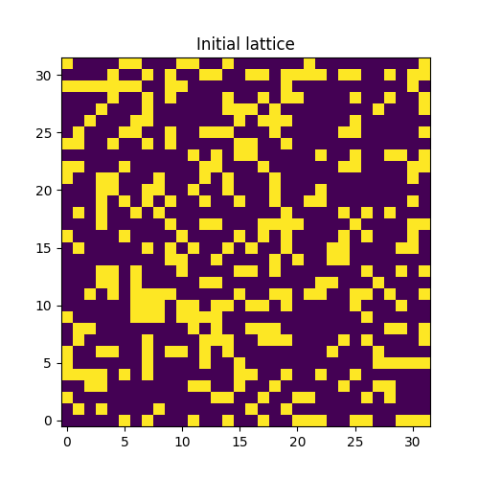
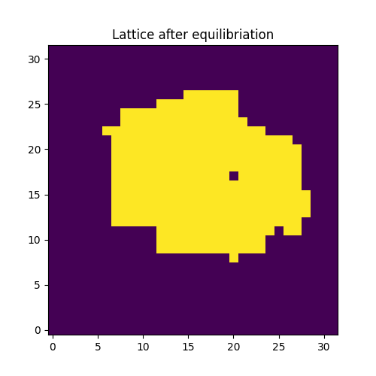
Step 1: Equilibration

Slide 5

Step 2: Simulation

Slide 6
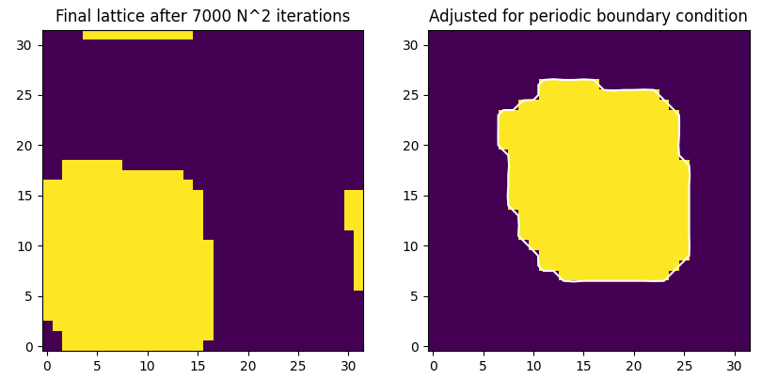
Step 3: Resolving Periodic Boundary Condition

Slide 7
Step 4: Drawing Phase Boundary using SVMs

Slide 8
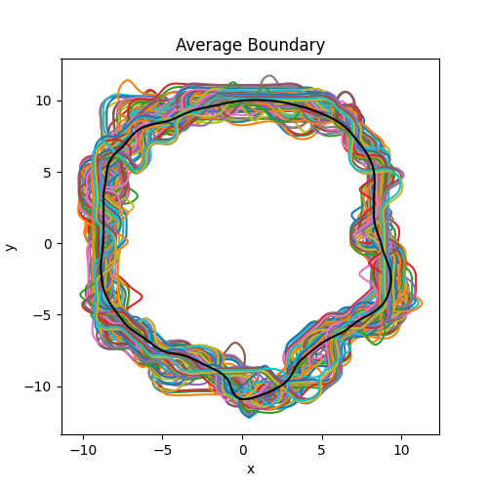
Step 5: Averaging Phase Boundaries

Slide 9
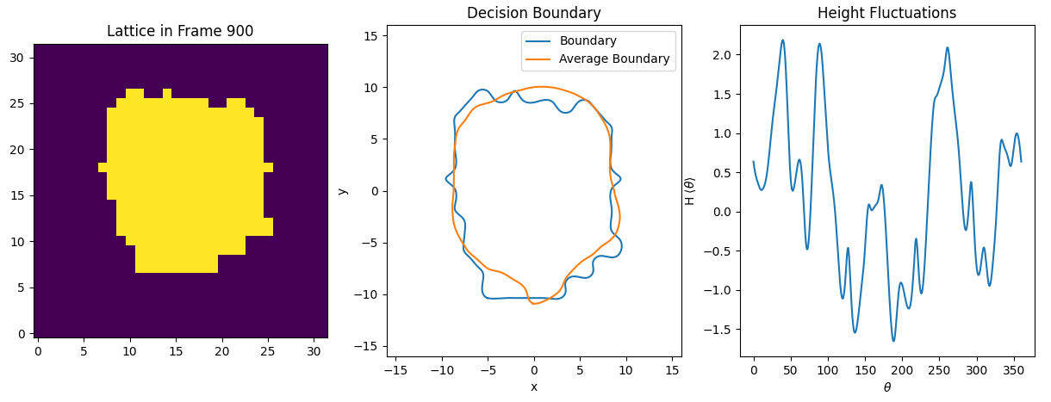
Step 6: Calculating Phase Boundary Fluctuations

Slide 10
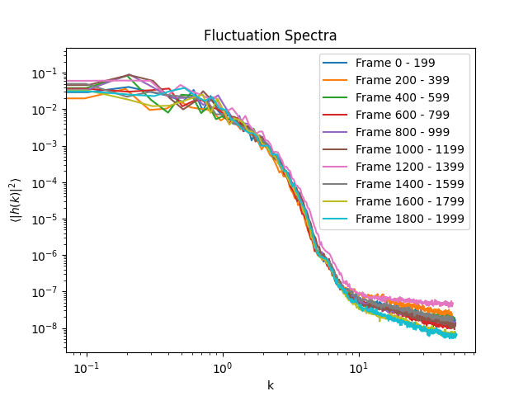
Step 7: Obtaining Phase Boundary Fluctuation Spectra

Slide 11
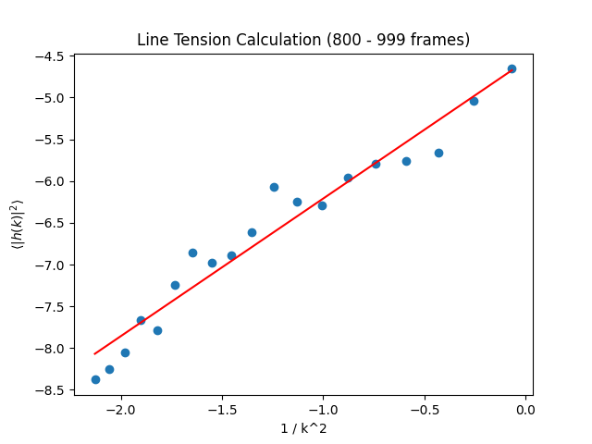
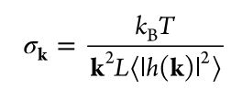
Step 8: Calculating Line Tension

Slide 12
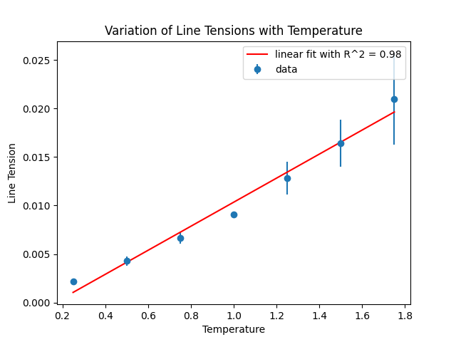
Result

